Slide 1
Matter Museum
2nd Grade

Slide 2
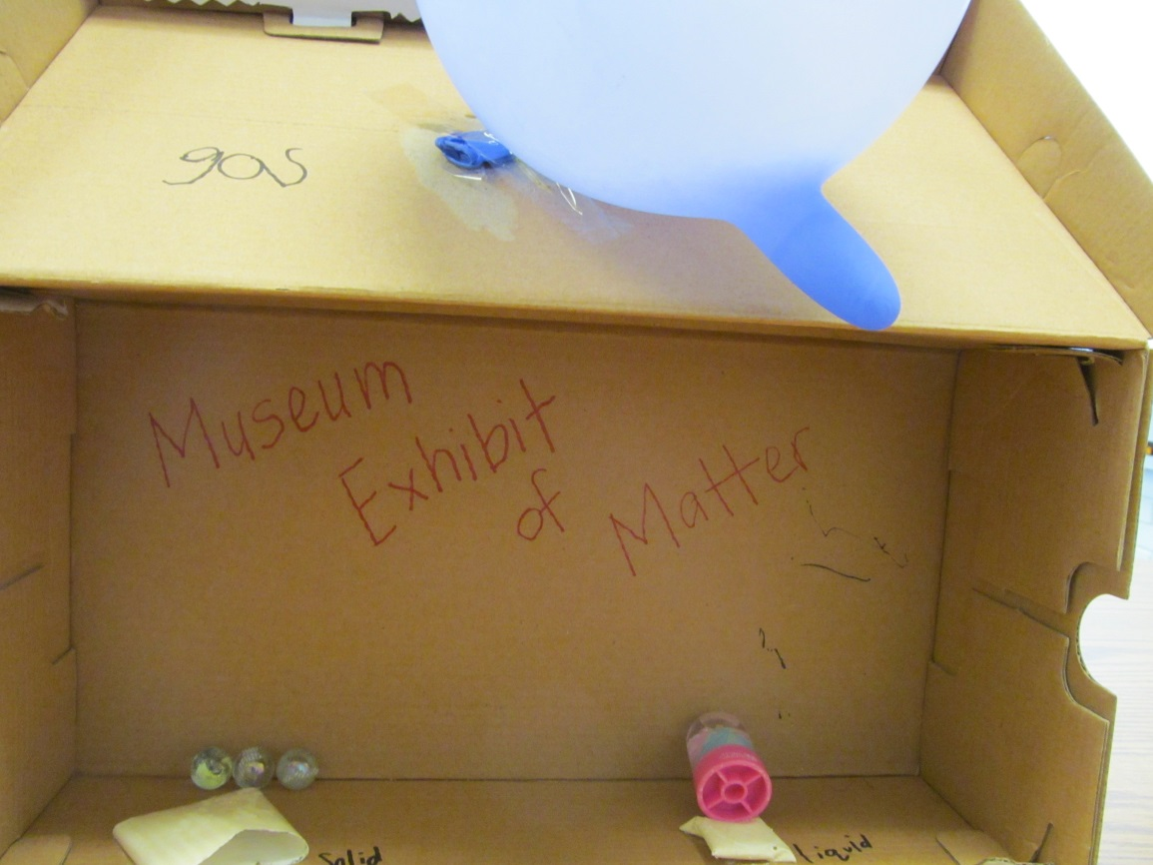
Shoe Box of Matter
Solid – Marbles
Liquid – Water in a Snow Globe
Gas – Air in a Plastic Glove

Slide 3
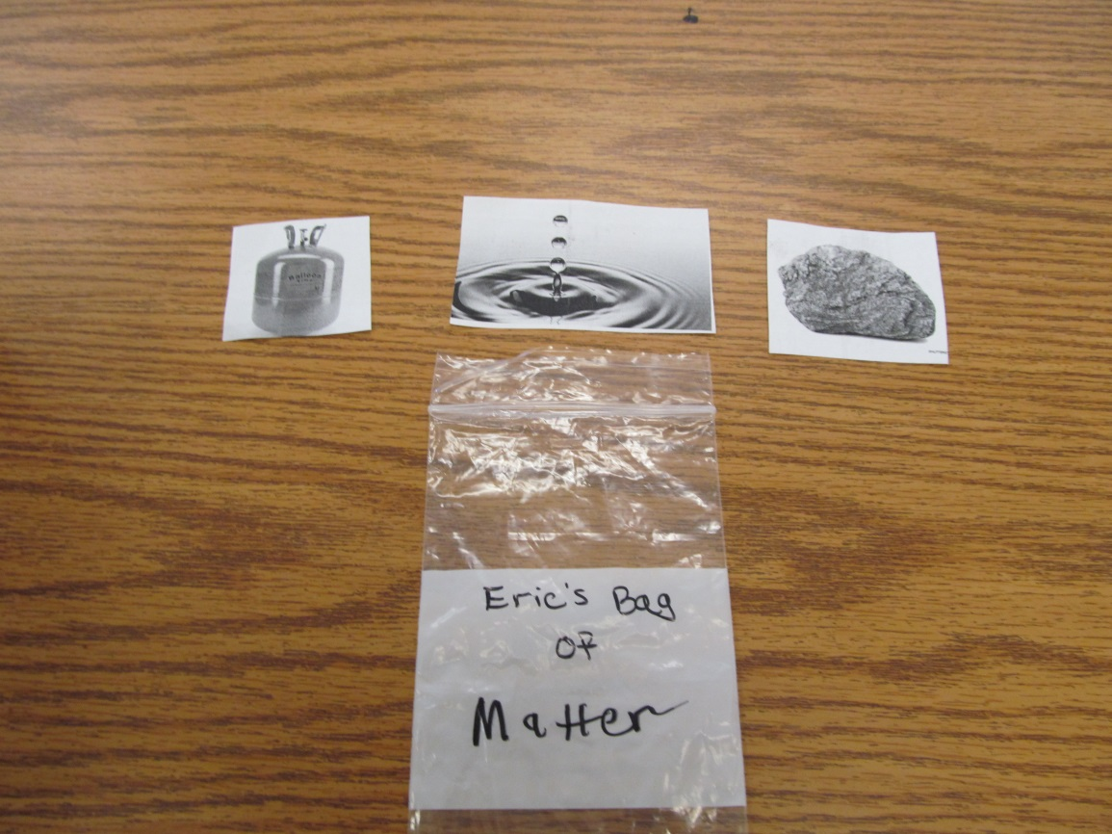
Bag of Matter
Solid – Rock
Liquid – Raindrop
Gas - Helium

Slide 4
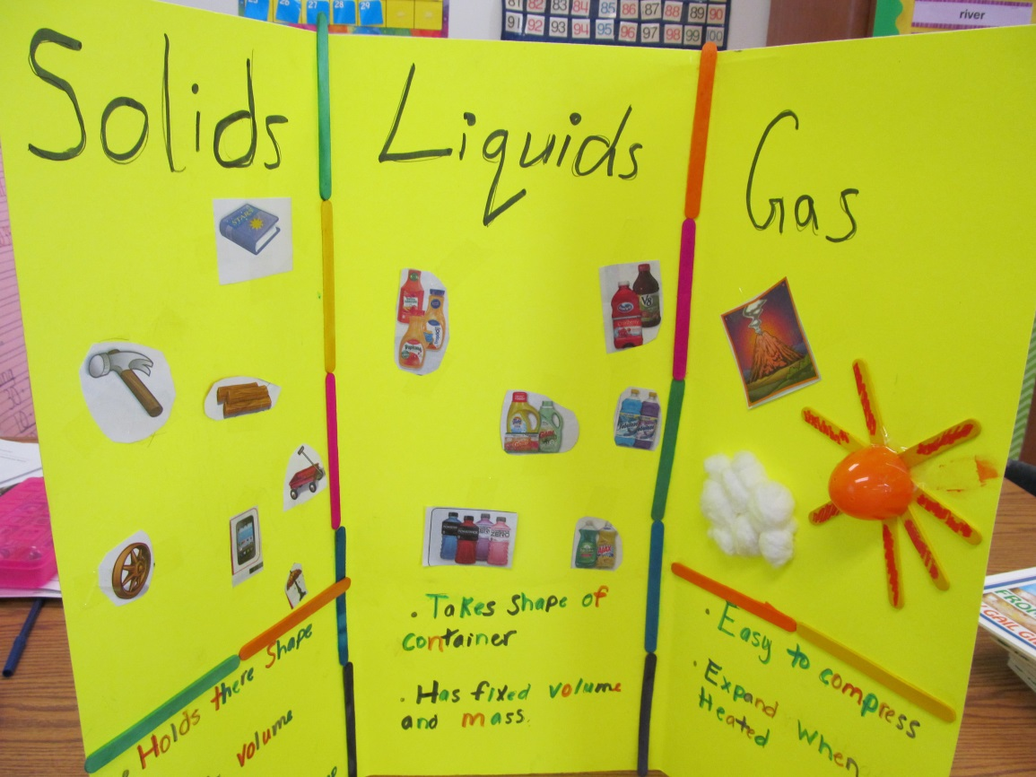
Matter Poster
Solid – Book, Hammer
Liquid – Juice, Liquid Detergent
Gas – Clouds, Sun

Slide 5
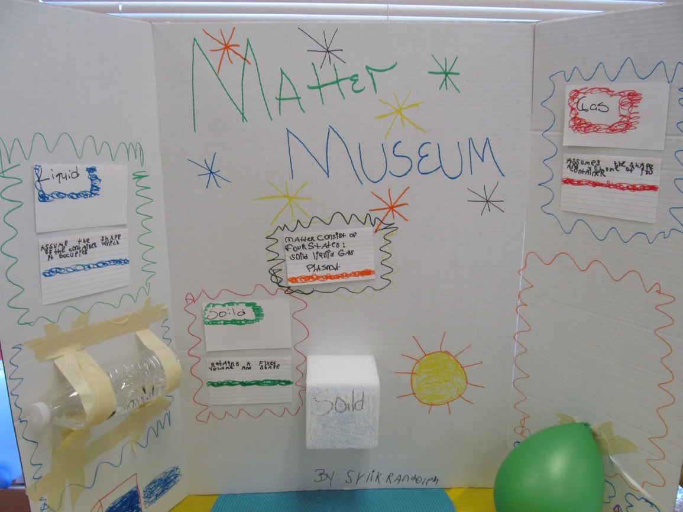
Matter Poster
Solid – Styrofoam Cube
Liquid – Water
Gas – Air in a Balloon

Slide 6
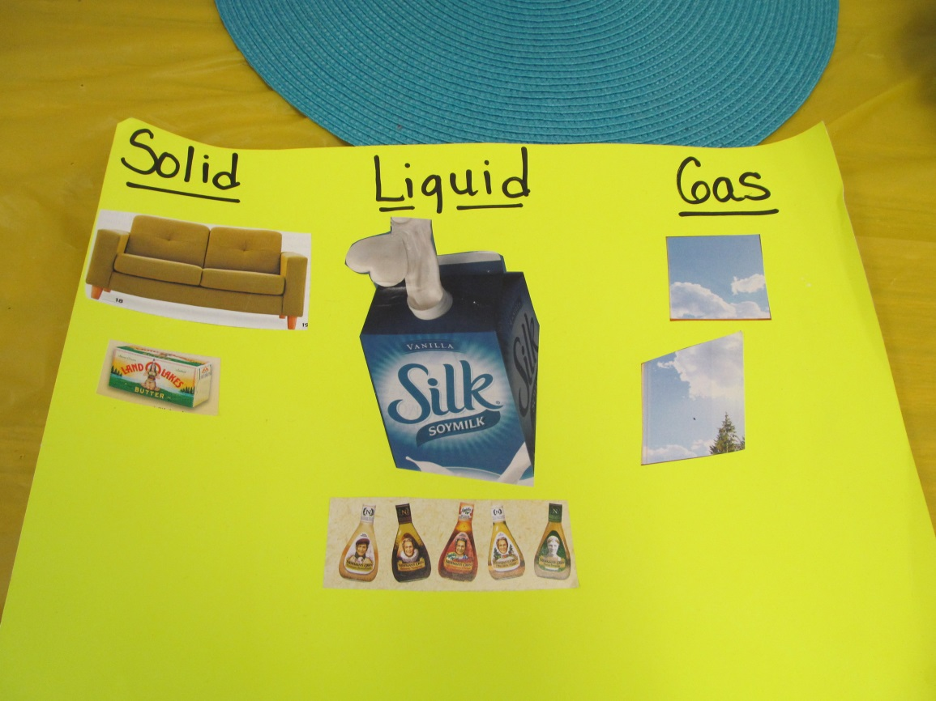
Matter Poster
Solid – Sofa, Butter
Liquid – Milk, Salad Dressing
Gas – Clouds, Smoke

Slide 7
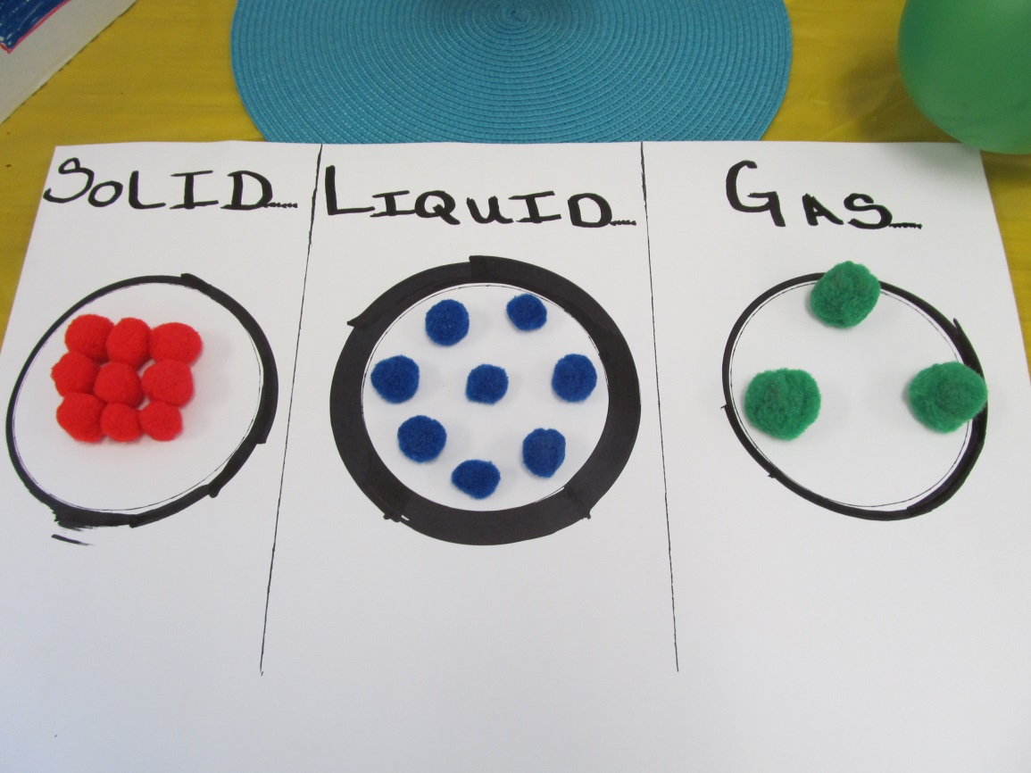
Matter Particles
Solid – Particles are packed tightly
Liquid – Particles are close together
Gas – Particles are separated and free

Slide 8
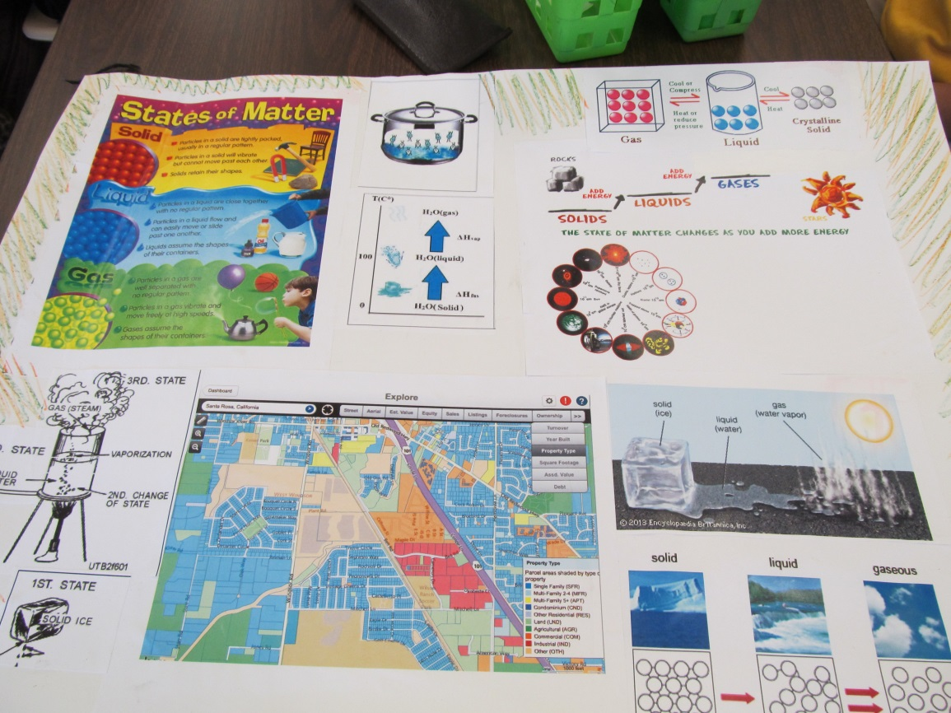
Informational Poster
When an ice cube is heated, it melts and turns into a liquid.
When a liquid is heated or boiled, it turns into water vapor or steam.

Slide 9
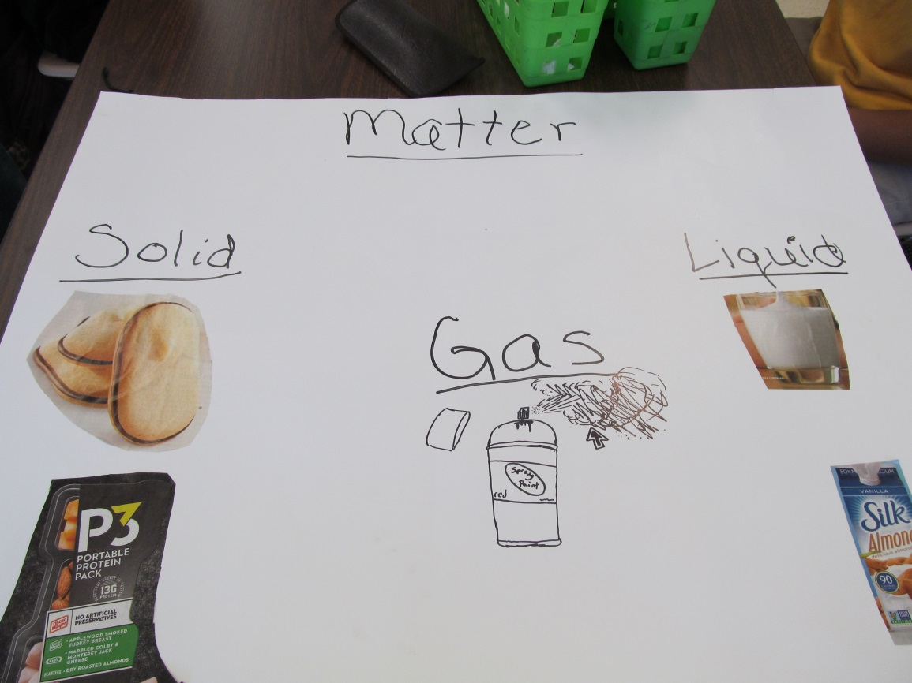
Matter Poster
Solid – Cookies
Liquid – Milk
Gas – Aerosol Mist

Slide 10
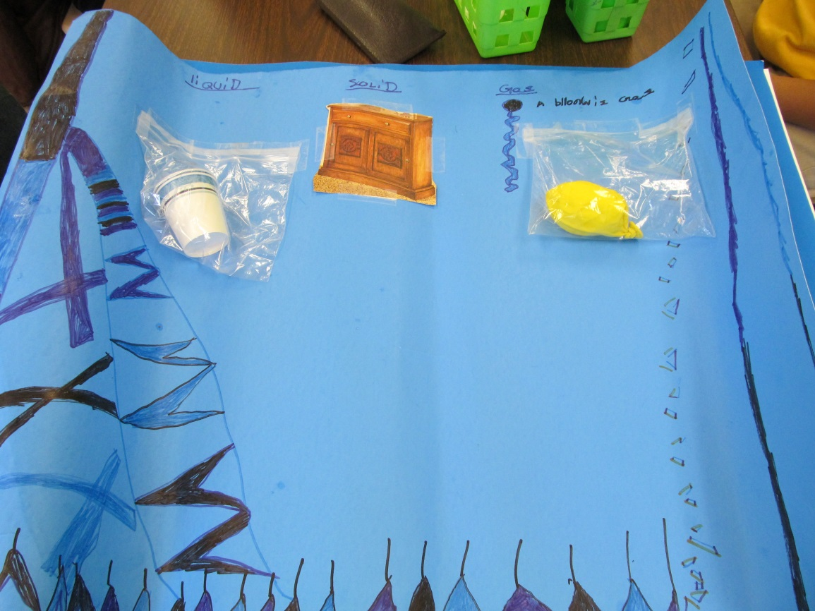
Matter Poster
Solid – Desk
Liquid – Water
Gas – Air in a balloon

